Slide 1






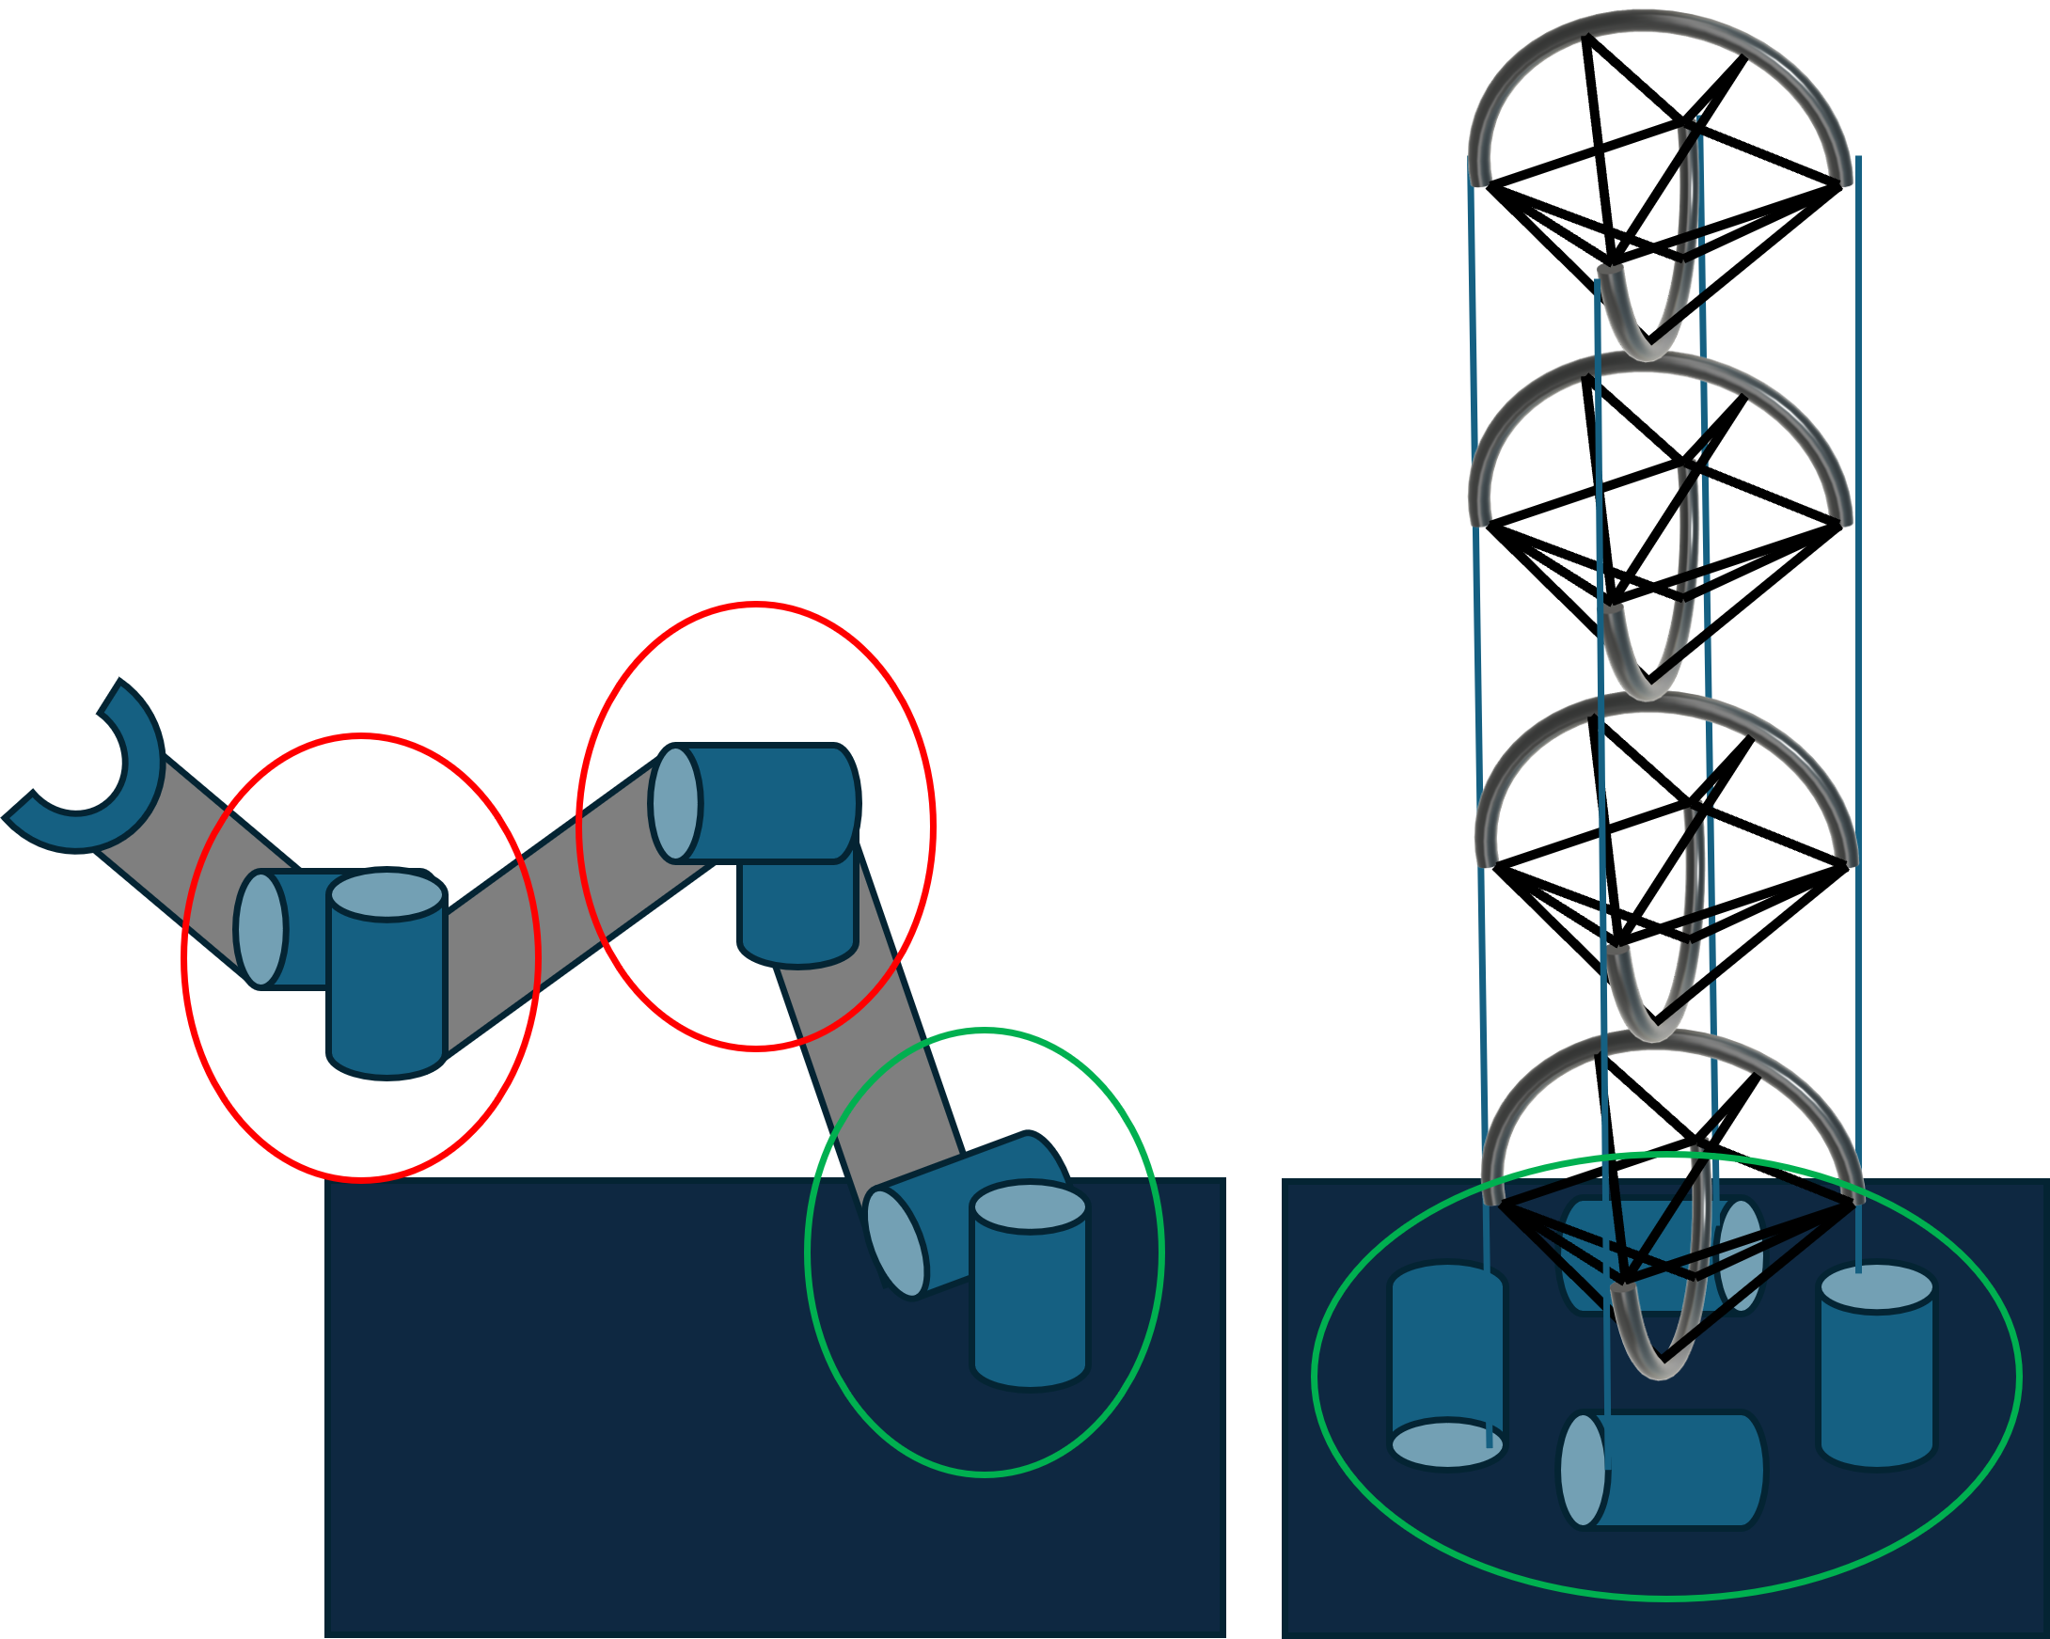
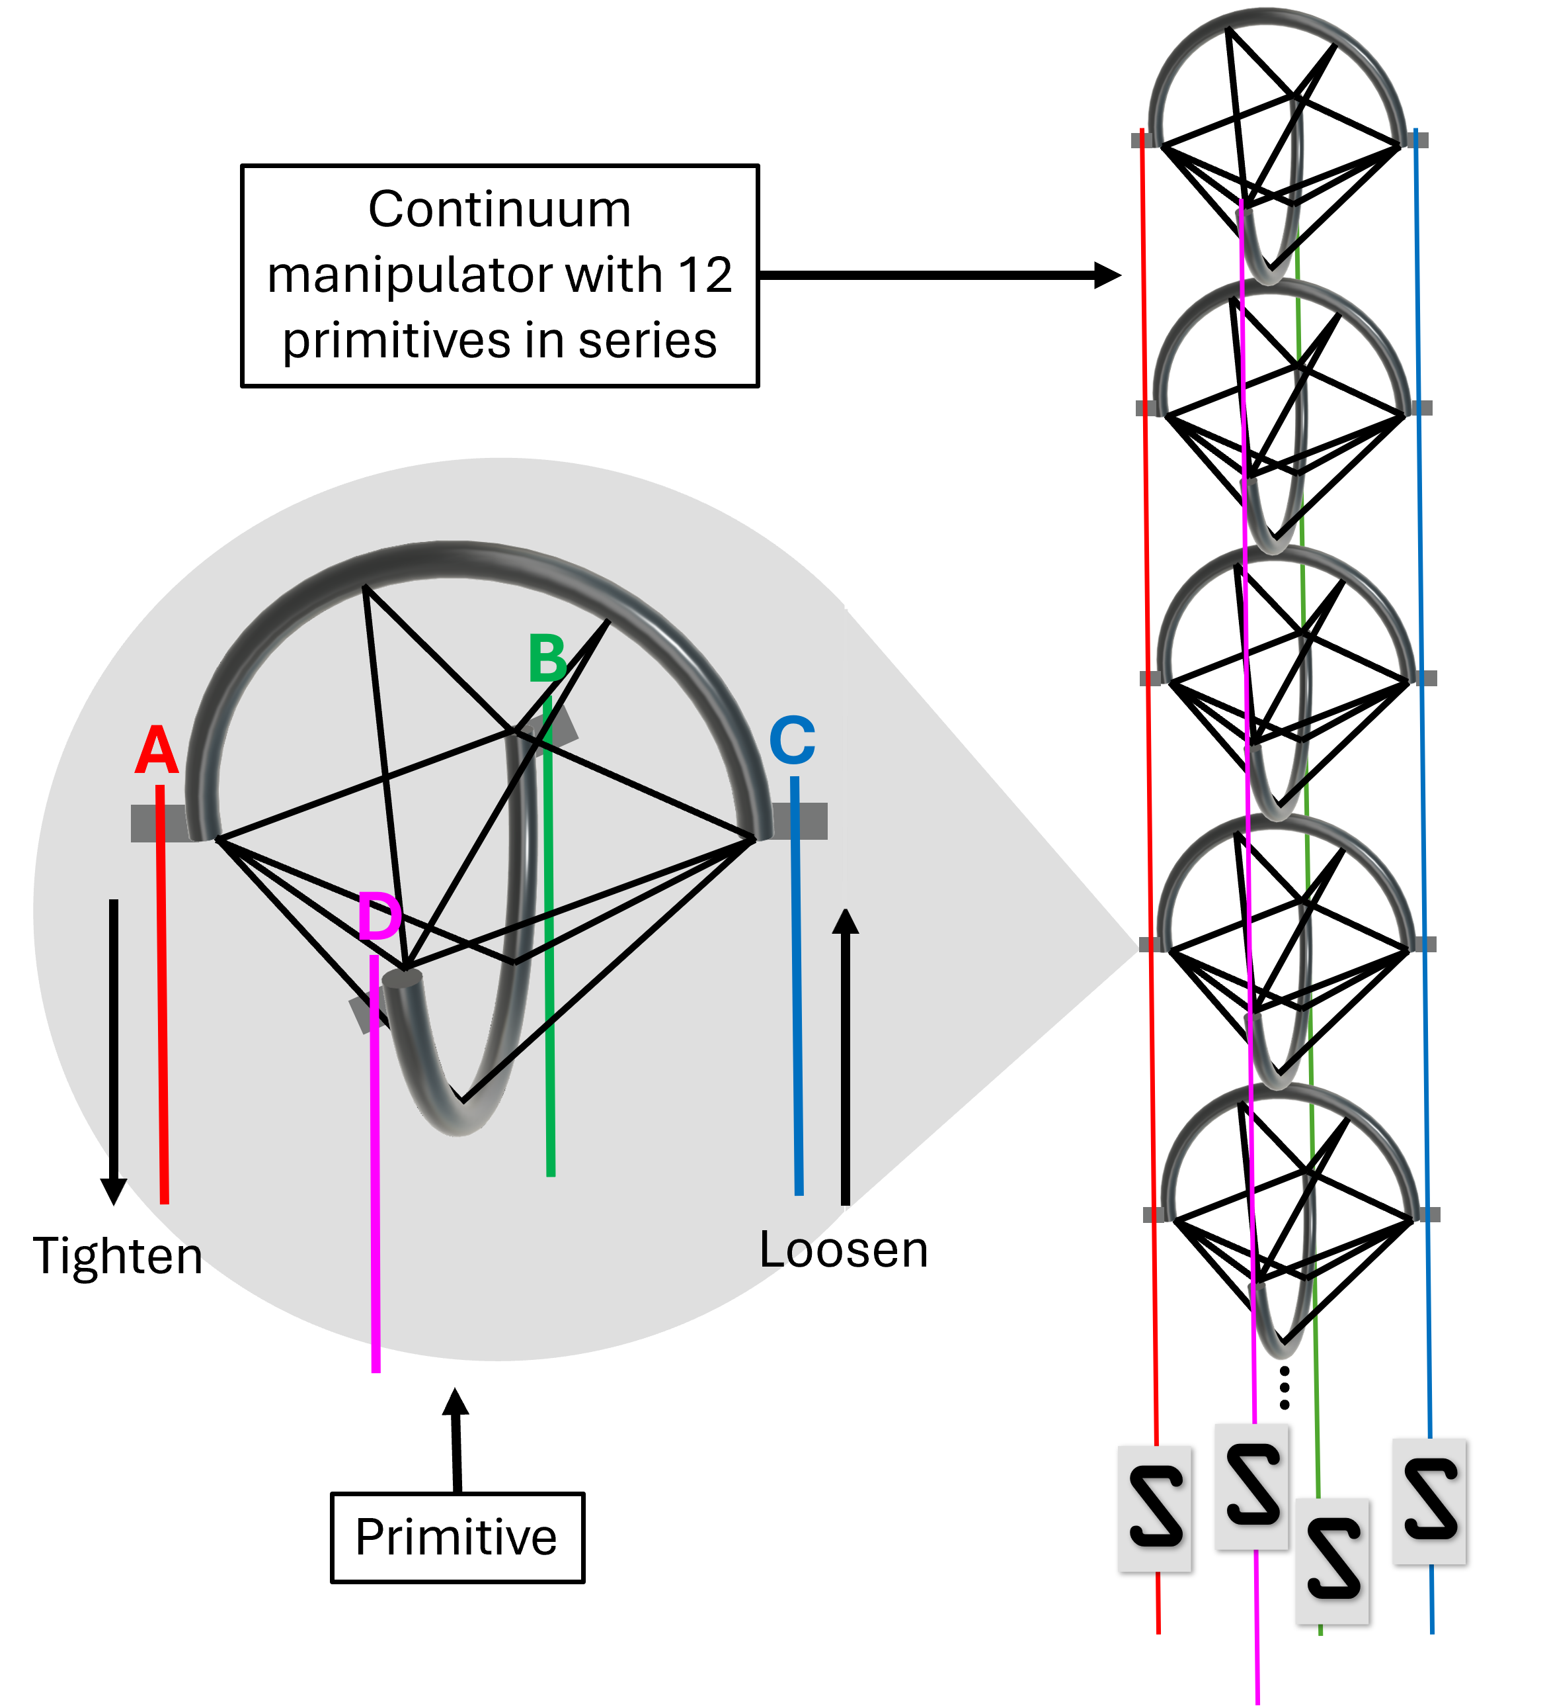
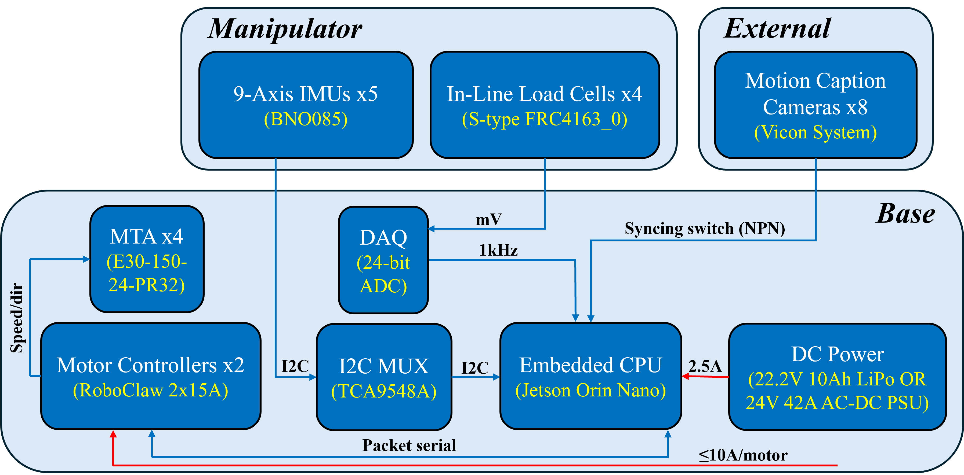
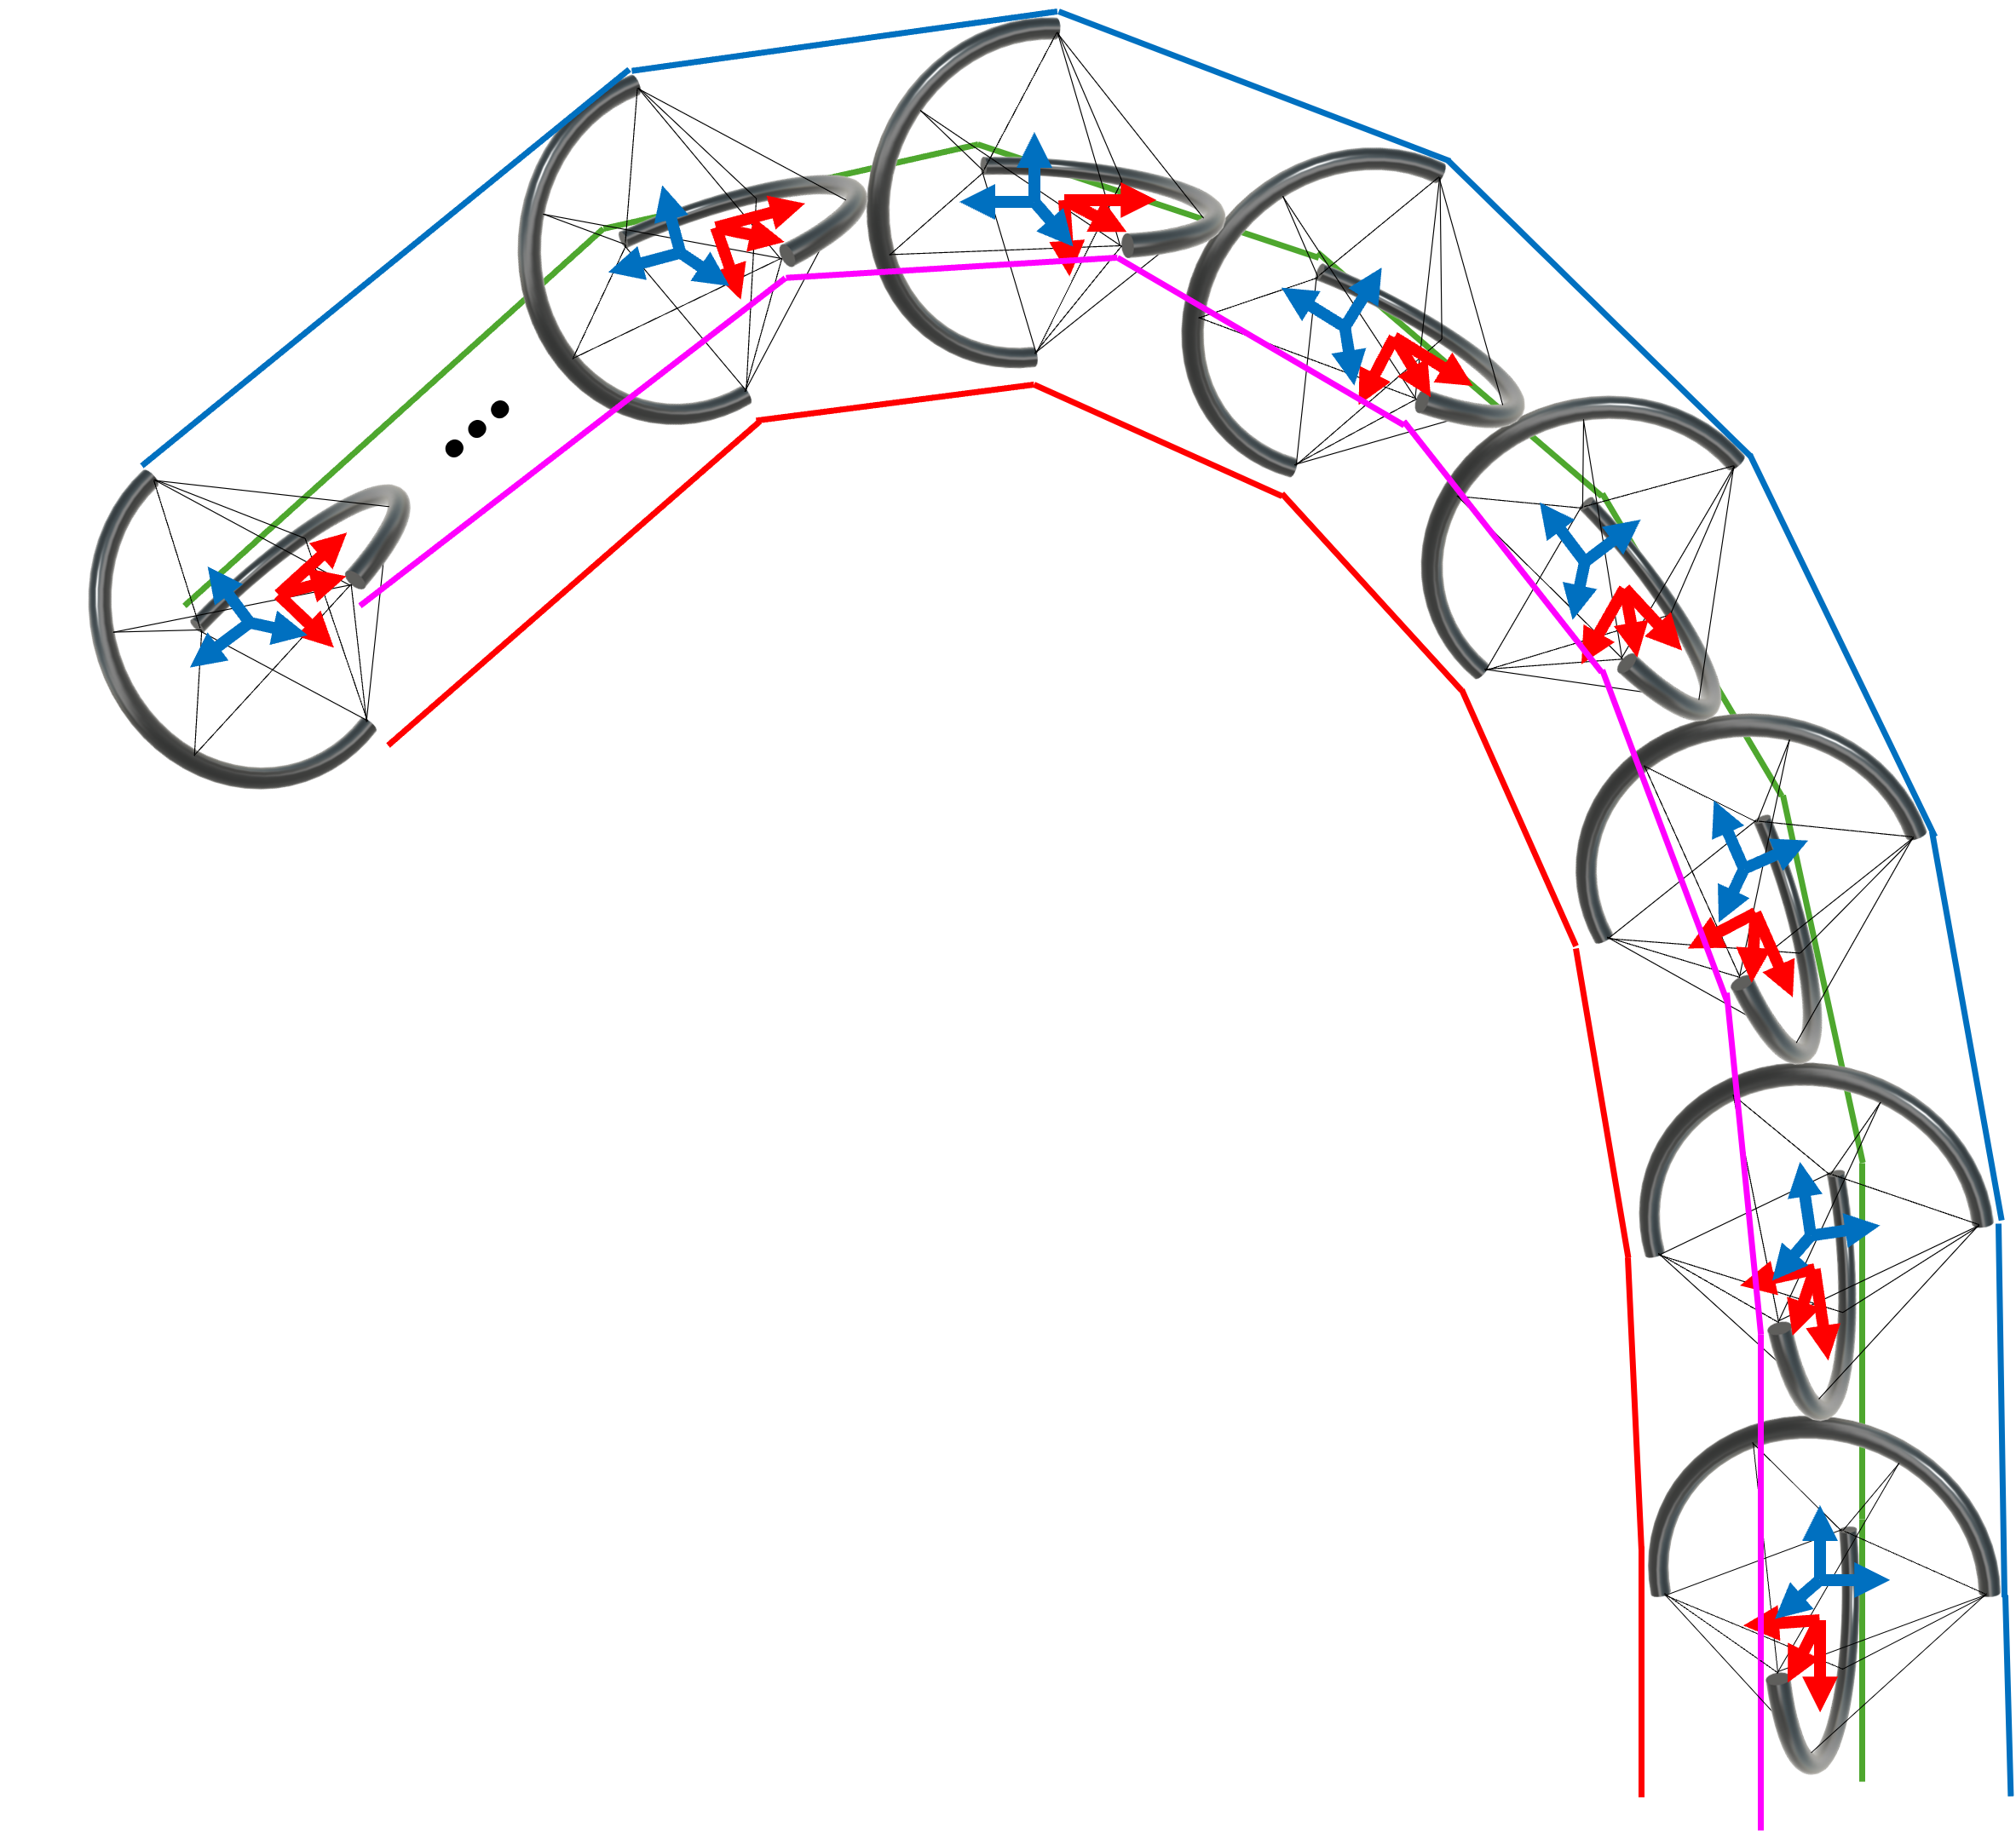
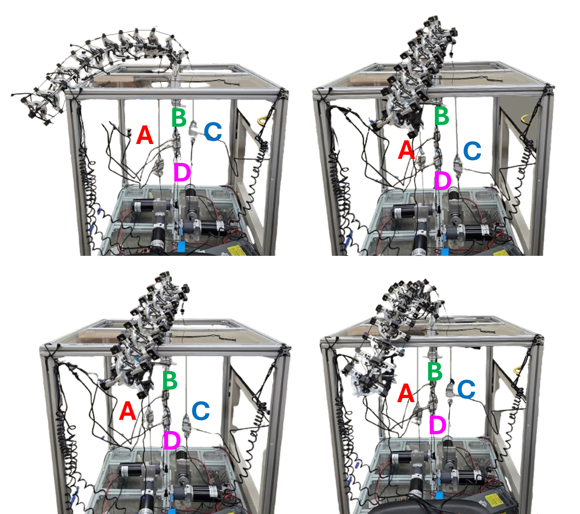
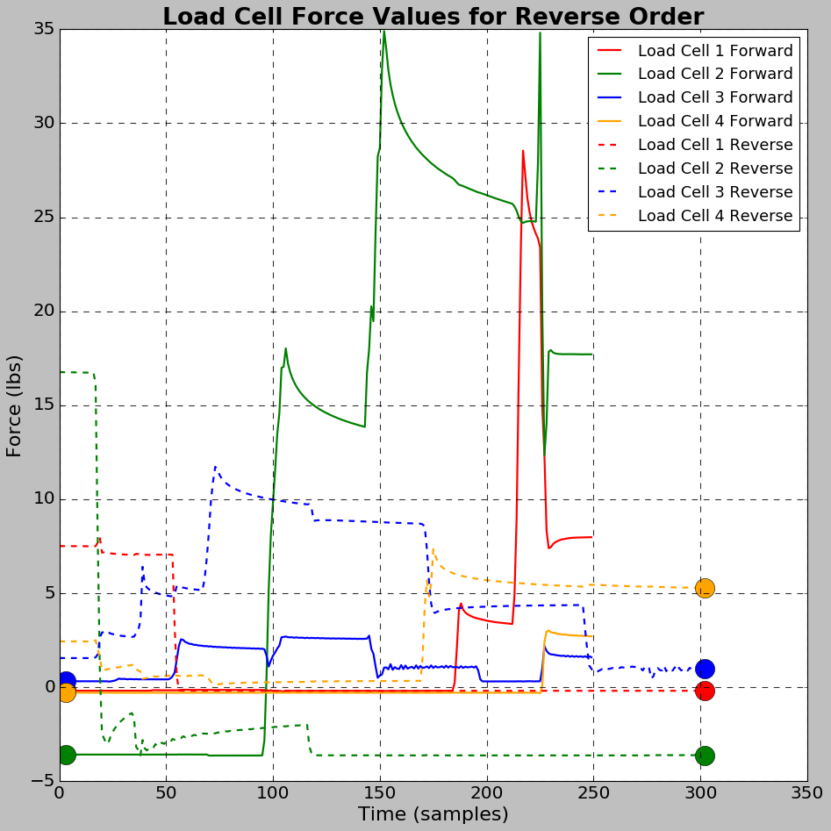
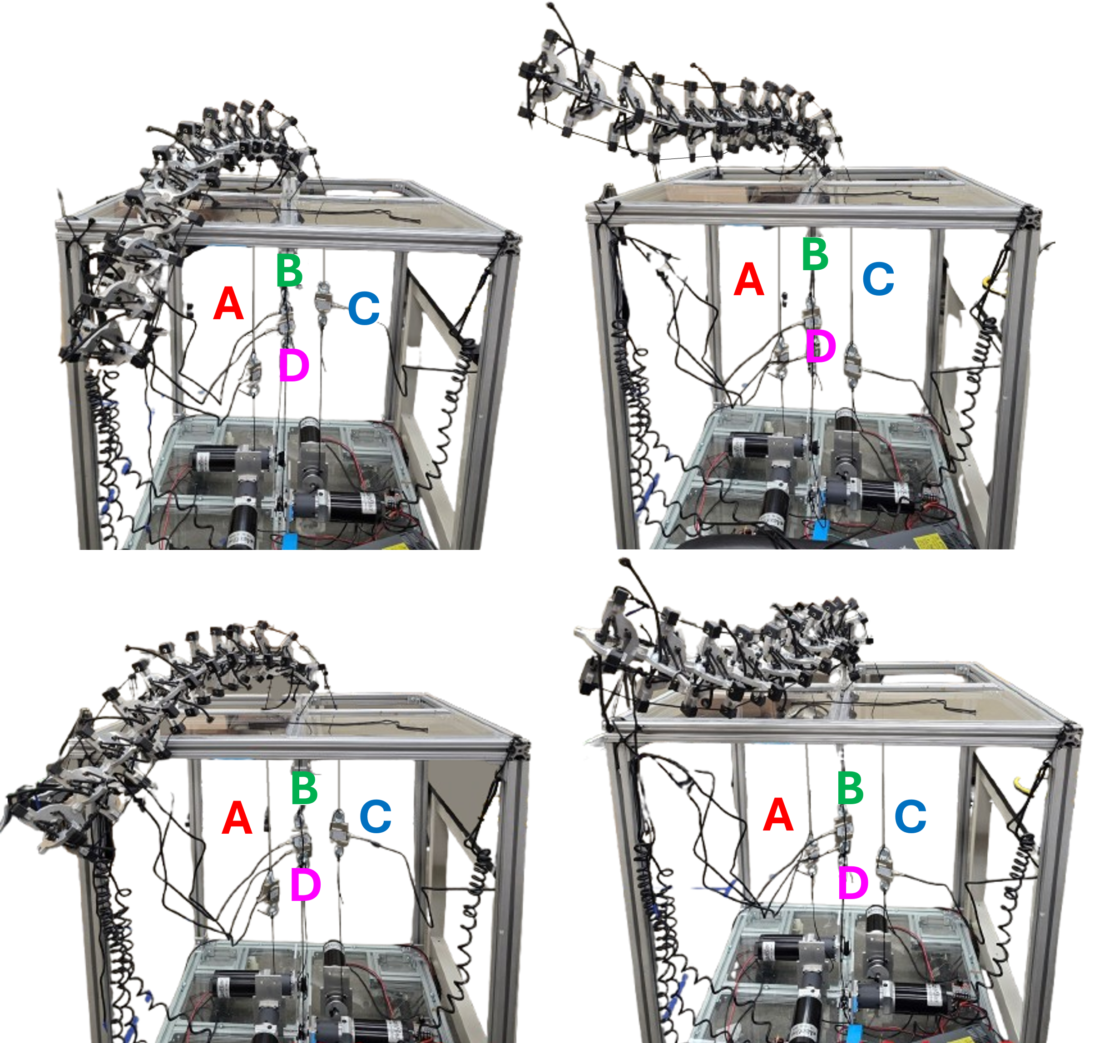
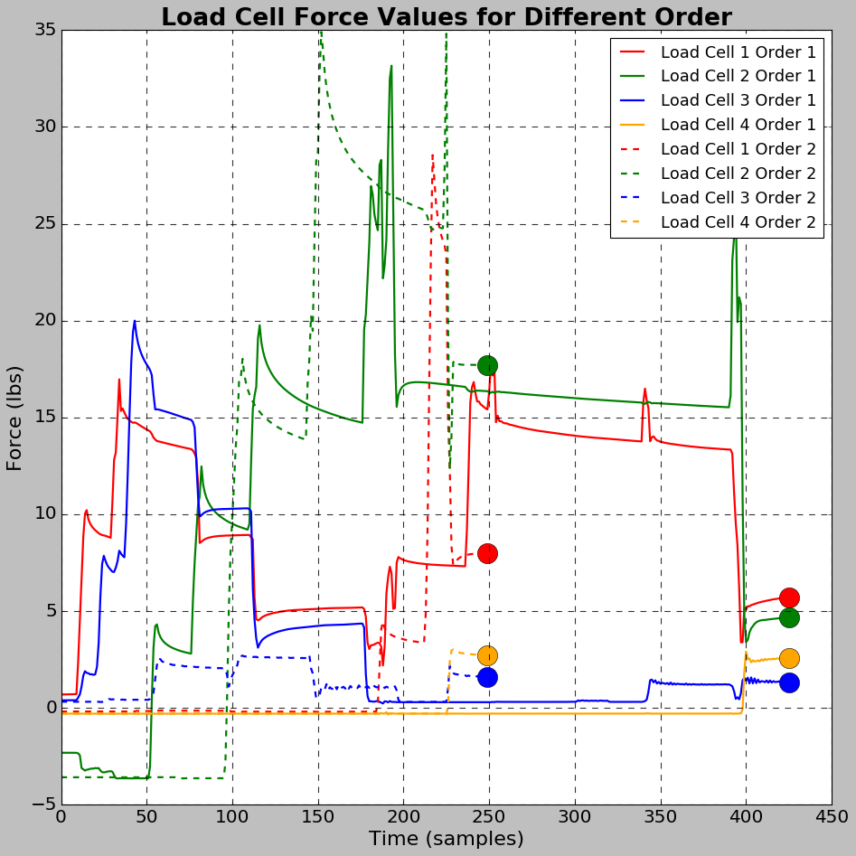


Mechatronic Design and Non-Commutative Behavior of a
Cable-Driven, Underactuated Tensegrity Manipulator
Lauren Ervin, Harish Bezawada, and Vishesh Vikas
Agile Robotics Lab, The University of Alabama
Introduction and Motivation
Design, Mechatronics, and Fabrication
Tensegrity mechanisms are an attractive option for space applications as they are internally stable, i.e., their shape remains the same regardless of gravity. Tensegrity continuum arms can contain a higher strength-to-mass (S2M) ratio than other manipulators. This is partially due to fixing all cable-driven motor tendon actuators (MTAs) to the base [1, 2]. This increases the lifting capabilities without the need for counterweights [3].
Design Requirements
Lightweight: the REACH robot should contain a S2M >2.
Compliant: it should be able to interact with the environment without drastically changing trajectory or becoming damaged.
Modular: primitives should be easy to add/remove for length altering, and the design is primitive invariant.
System Design
The system is controlled with 4 MTAs fixed at the base, 5 IMUs on the manipulator, and 4 load cells along the tendons. The base sits most of the electronics, i.e., the embedded system, power, and data collectors. External power from a Vicon system allows for data syncing with the on-board system.
Fig. 1: A rigid arm with motors attached throughout vs. a manipulator with motors fixed at the base with a lower CoM.
Reality Gap: A compliant manipulator with a high S2M ratio well-suited for space applications remains undeployed in real-world scenarios.
Contributions:
REACH: The system design is presented for the Redundant, Extrinsically-Actuated Continuum Handling (REACH) robot.
Non-Commutative Behavior: A set of experiments show the non-linear nature of the manipulator: (1) the start and end positions of a forward and reversed path, (2) the end position of the same path in a modified order.
Fig. 2: The REACH robot is controlled via four tendon cables with in-line load cells measuring cable tension.
Fig. 3: System integration between electronics on the manipulator, base, and external.
Non-Commutative Behavior Experiments
Future Works
Commands in Reverse Order are Not Equivalent
For two sequences with the same motor commands going forwards and then backwards, the backwards sequence will not always end the same that the forward sequence started in.
Different Order, Different Output
When starting in the same configuration, the same set of commands performed in a slightly altered order can result in two unique endpoints.
Dynamic modeling
a)
b)
a)
b)
c)
d)
c)
d)
Fig. 8: Full manipulator dynamics
References
I. D. Walker, “Continuous backbone “continuum” robot manipulators,” International Scholarly Research Notices, vol. 2013, no. 1, p. 726506,2013.
G. Robinson and J. Davies, “Continuum robots - a state of the art,” in Proceedings 1999 IEEE International Conference on Robotics and Automation (Cat. No.99CH36288C), vol. 4, pp. 2849–2854 vol.4, May 1999. ISSN: 1050-4729.
H. Bai, B. G. Lee, G. Yang, W. Shen, S. Qian, H. Zhang, J. Zhou, Z. Fang, T. Zheng, S. Yang, L. Huang, and B. Yu, “Unlocking the Potential of Cable-Driven Continuum Robots: A Comprehensive Review and Future Directions,” Actuators, vol. 13, p. 52, Feb. 2024. Multidisciplinary Digital Publishing Institute.
Fig. 4: The REACH robot following a forward path from a) to b),then the same path reversed from c) to d).
Fig. 5: The load cell values throughout the forward and reverse paths taken in Fig. 4.
Fig. 6: The REACH robot following the same set of traversal paths in two slightly different orders.
Fig. 7: The load cell values throughout the same set of commands in two slightly different orders shown in Fig. 6.
This work is supported in part by NASA grant #80NSSC20M0044 awarded to the Alabama Space Grant Consortium and USDA/NIFA under Grant 2023-67022-40918

